Slide 1
ES Lab: NJESTA Share-a-thon The Reasons for the Seasons
Angela Best, NJSTA President
Earth Science Teacher
Monroe Township Middle School
Angelanbest@gmail.com

Slide 2
The Reasons for the Seasons
Hands on
small groups
This activity and more available at: http://www.mjksciteachingideas.com/

Slide 3
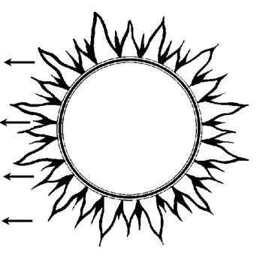
Activity #1
Teacher led demo
Spring
Vernal Equinox
March 21-22
Summer
Summer Solstice
June 21-22
Winter
Winter Solstice
Dec. 21-22
Autumn
Autumnal Equinox
Sept. 21-22

Slide 4
Direct or Indirect
Activity #2

Slide 5
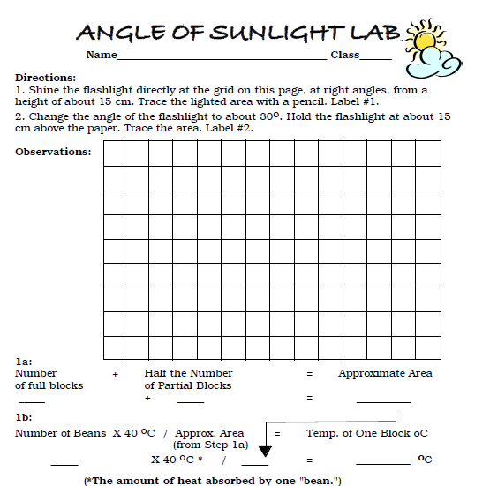
Activity # 3
Small Group

Slide 8
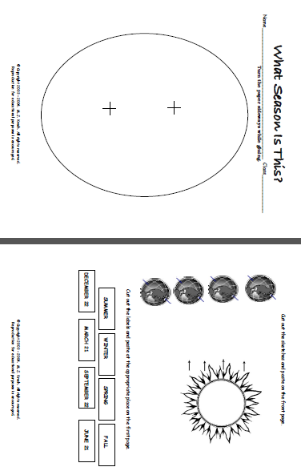
More Practice

Slide 9
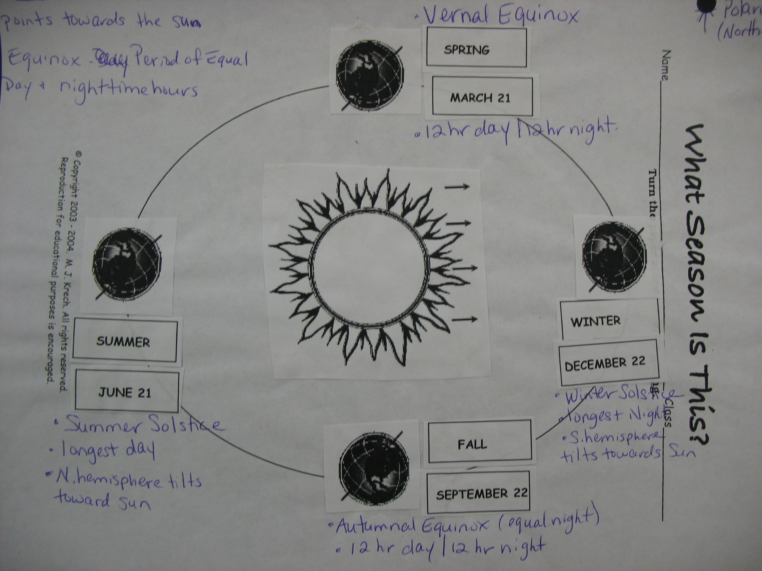

Slide 10
The Reasons for the Seasons
Manipulate different variables to investigate their effect on seasons.
http://www.learner.org/jnorth/tm/mclass/season_simulator.html

Slide 11
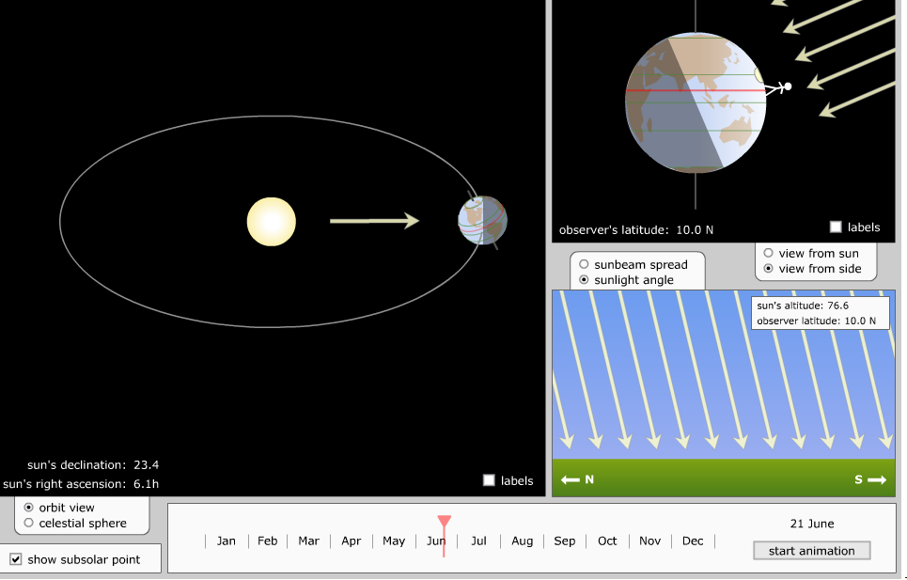

Slide 12
Solar Demonstrator
The “green Horizon Disk” represents a piece of the surface of the Earth
The round head of the brass paper fastener represents the Sun
The swinging “Month” arm: time of the year, and daily path over the Earth
The “Latitude” part of the Frame is used to adjust the Horizon Disk

Slide 13
Solar Demonstrator
Students visit four different latitudes over the course of four seasons.
Observe length of day and location of sunrise/sunset

Slide 14
The Sun in Motion
One week of never ending sun
http://www.youtube.com/watch?v=RdTduSstXVM
Winter Solstice, Fairbanks Alaska
http://www.youtube.com/watch?v=jb6kG5oXTRU&feature=related

Slide 15
ES Lab: NJESTA Share-a-thon
This powerpoint will be posted on the NJESTA website.
Questions???
angelanbest@gmail.com

